Slide 1

Yet Another ULSD Study- EIA Assumptions
James Kendell
Director
Oil and Gas Division
Energy Information Administration
NEMS/AEO Conference
March 27, 2001

Slide 2
Request of House Committee on Science
EIA to Study EPA’s Final Rule on Sulfur in On-Highway Diesel
Use EPA’s Major Assumptions from Regulatory Impact Analysis of Final Rule
Sensitivity Analysis Where EPA and Industry Assumptions Diverge Significantly

Slide 3
Comparisons of Ultra-Low-Sulfur Diesel Studies: Methods
Individual Refinery Representation
Charles River Associates/Baker and O’Brien, Inc.
EPA
EIA Short-Term
LP Model Representation or Estimate Based on LP Results
NPC Mathpro EnSys
  DOE EIA Long-Term

Slide 4
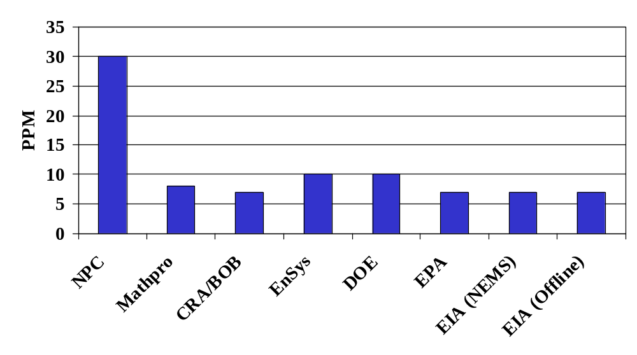
Sulfur Content at the Refinery Gate

Slide 5
Phase-in Vs. Full Compliance
 | NPC | Math pro | CRA- BOB | EnSys | DOE | EPA | EIA- NEMS
Phase -In |  |  |  | 25% to 100% | 5% to 100% | 80% | 80%
100% ULSD

Slide 6
Geographic Coverage
PADD | NPC | Math pro | CRA/ BOB | EnSys | DOE | EPA | EIA-offline | EIA NEMS
I
II
III
IV
V
US

Slide 7
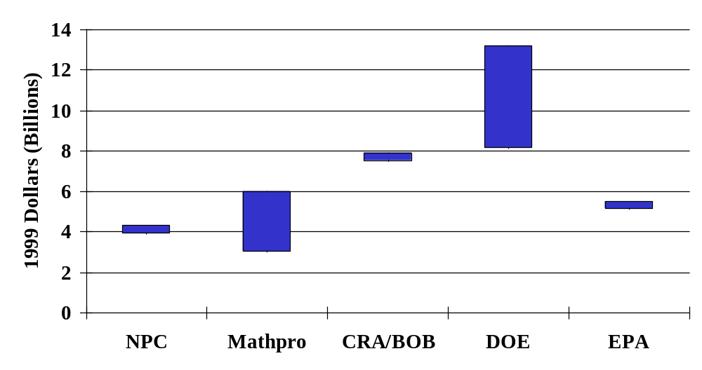
Refinery Investment

Slide 8
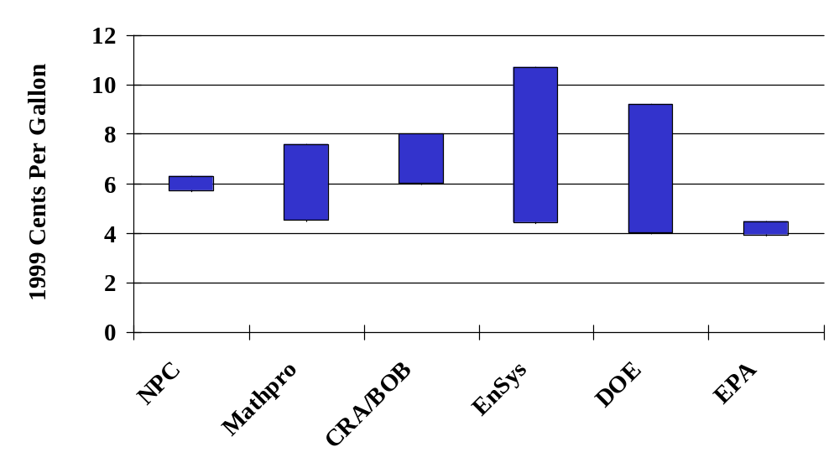
Increase in Refining Cost

